Slide 1
Module 7
Experimental study design considerations

Slide 2
Lecture objectives
Become familiar with the factors to consider before starting in vitro, cell culture, or animal studies
Recognize the importance of power and how it influences the study design
2
2
2
2
2
2

Slide 3
Lecture: Study design consideration
Start with a research question, then consider:
Type of research/model (in vitro, cultured cells, animals, humans)
Study population and study sample
Study sample’s characteristic that you want to measure/study
Assays/methods that you will use to investigate
Number of replicate assays, sample size (independent or biological replicates)
Statistical analyses you will use to answer your research question
3
3
3
3
3
3

Slide 4
Study design
Research question
Examples:
- Effect of a drug on a disease outcome?
- Investigation of what signaling pathway is turned on by…?
- Could a test be a biomarker for a given disease?
- What are the risk factors associated with a given disease/diagnostic/outcome?
Exploratory (pilot) or confirmatory? are you “looking” for a potential signal or are testing a hypothesis?
It’s OK to explore in order to “generate hypotheses”, as long as you don’t treat the exploration as a confirmatory study
Often don’t have enough information to go straight into the big study
Sometimes you feel you have enough info but not enough $
4
4
4
4
4
4
4

Slide 5
Study design – pilot or exploratory study
Exploratory, meant to generate data that will:
- tell you if something is worth pursuing at all
- hypothesis generating
- is there any signal? You need to know before going further
- serve as preliminary data in a grant application
- small (= inexpensive) experiment that catches the attention of reviewers, shows feasibility and convinces them that you should study this in more detail
- allow you to determine how you should do the “definitive” study
- preliminary data to allow sample size calculations, to ensure that the “definitive” study will be powered to answer the research question
Size of exploratory study often dictated by feasibility (time and $)
5
5
5
5
5
5
5
5

Slide 6
Study design – pilot or exploratory study
Good time to refine your method/assay
Get information that will be needed by biostatistician and later for publication, to explain how you calculated your sample size
Questions you may want to answer at this stage:
- What are the sources of variability, error, bias?
- How feasible is my intended study?
- How long does it take? How $
- How many replicates (assay/technical/independent) do I need?
6
6
6
6
6
6
6
6
6

Slide 7
Study design – Types of study/research
In vitro experiments/assays
Cell culture model
Animal model
Humans/clinical samples
Complexity
of the study
Variability
In vitro and cell culture experiments are usually shorter and can often deal with a more complex study design (e.g., varied exposures. Duration, etc.)
Animal studies have more sources of variability and human studies have the most because of social determinants of health, genetics, environmental exposures, etc…
7
7
7
7
7
7
7
7
7
7
7

Slide 8
In vitro or cell experiments – replicates
Types of replicates (example for cell culture study)
1. assay replicates
- e.g., same cell pellet assayed X times at the same time
2. experimental or technical replicates
- e.g., number of flask or well per group, done at the same time
3. independent replicates
- experiments repeated on same cell line at another time
4. biological replicates
- experiment repeated on a different cell line

Slide 9
In vitro or cell experiments – replicates
Seeding flask
n=3 is minimum
to generate error bars
Technical replicates
Flask or well (n=3)
Assay replicates
Each flask or well assayed 3 times
n= 1
To obtain independent replicates, the whole thing should be repeated a minimum of 3+ additional times for each condition tested if you wish to report statistics

Slide 10
In vitro or cell experiments – replicates
Seeding flask
+ treatment
Medium?
no treatment
(vehicle)
Flask or well
Data
(3X)
41
40
39
48
52
47
46
42
45
35
39
36
45
49
47
32
33
35
40 ± 1
49 ± 3
44 ± 2
Assay CV?
37 ± 2
47 ± 2
33 ± 2
mean (range) CV=
4.5 (2.5-5.7)%
44 ± 5 (n=3, CV~11%)
39 ± 7 (n=3, CV ~18%)
39
52
46
Where is the variability
coming from?
36
49
32
10
10
10
10
10
10
10
46 ± 7 (n=3, CV~14%)
10
39 ± 9 (n=3, CV~23%)

Slide 11
In vitro or cell experiments – replicates
Seeding flask
+ treatment
Medium?
no treatment
(vehicle)
41
40
39
48
52
47
46
42
45
35
39
36
45
49
47
32
33
35
40 ± 1
49 ± 3
44 ± 2
37 ± 2
47 ± 2
33 ± 2
44 ± 5
Would need n~32 to detect this difference
39 ± 7
For JASP:
Cohen’s delta = difference in means/SD
44 ± 3
Would need n=6 to detect this difference
39 ± 3
44 ± 2
Would need n=3 to detect this difference
39 ± 2
11
11
11
11
11
11
11
11
11
11
11

Slide 12
In vitro or cell experiments – replicates
Seeding flask
Medium?
+ treatment
no treatment
(vehicle)
41
40
39
48
52
47
46
42
45
35
39
36
45
49
47
32
33
35
p = 0.066 (Mann-Whitney)
p = 0.008 (Wilcoxon sign rank)
p = 0.049 (t-test)
p = 0.008 (paired t-test)
44 ± 4 (n=9)
39 ± 6 (n=9)
Original study design
44 ± 5 (n=3)
Would not reach significance
39 ± 7 (n=3)
You may want to :
Optimize your experimental conditions to decrease variability
Increase your n where you need it
12
12
12
12
12
12
12
12
12

Slide 13
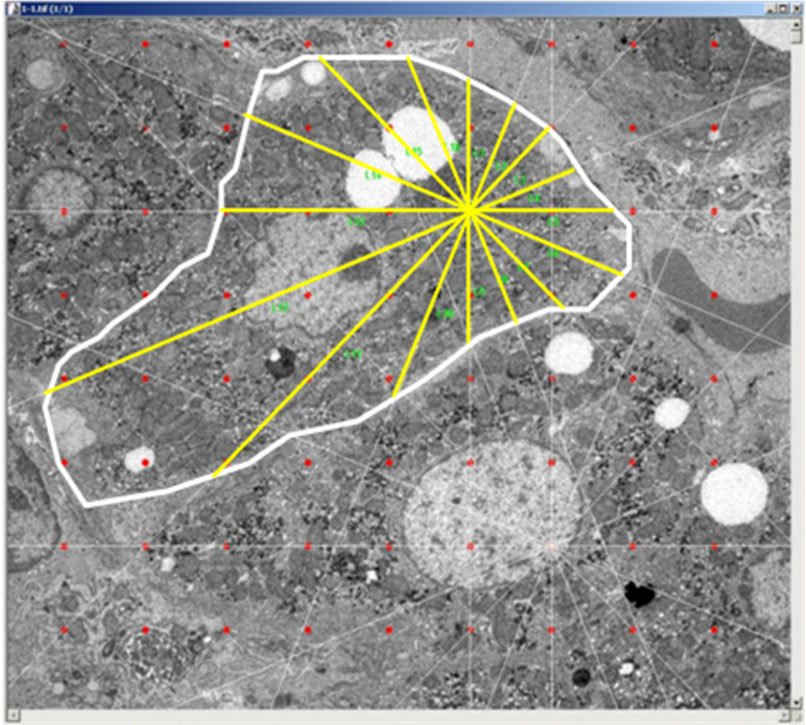
In vitro or cell experiments – replicates
Example: Mouse model of Huntington’s disease: HD+ vs. WT, young vs. old (4 groups, n = 10-12 animal per group, many images per animal)
Objective: To perform transmission electron microscopy (TEM) and do morphometric analyses of a) cell size, b) mitochondria number, and c) mitochondria size. Research question: do these differ with disease or age?
Obtained dozens of TEM images per animal, each containing many cells which each contain many mitochondria
Q1: What could be done to minimize bias? Not all cells look the same. Which one to measure?

Slide 14
In vitro or cell experiments – replicates
A1: Use a grid to minimize selection bias, have a pre-determined plan.
Ideally, try to be blinded as to what you are assaying (e.g. treated vs. control), and try to randomize -> It gives reviewers confidence when you can write that “all assays were conducted in a blinded and randomized fashion”
Q2: How does one decide how many images or cells per animal (replicates) to analyze for each measure?
%CV
Number of images or cells per animal
The n may not be the same for cells and for mitochondria

Slide 15
In vitro or cell experiments – replicates
My collaborator determined that analyzing 20 cells yielded the lowest stable CV on the cell size measure but because counting 20 cells was very time consuming, they analyzed only 3 animals in each of the 4 group (valuing accuracy)
20 cells x 4 groups x 3 animals per group = 240 cells
ended up comparing 4 groups of n = 3 → nothing reached significance
Q3: What may have been a better alternate study design?
look at 6 cells, compare 4 groups of n = 10!
→ 6 x 4 x 10 = 240 cells
Same amount of work, much more power
Entire summer wasted, no publication
15

Slide 16
In vitro or cell experiments – replicates
Need to balance variability in your measurement with having a sufficiently large sample size to have statistical power
To be able to do that, you need to have a good idea about the variability of
Your assay itself
Your sample

Slide 17
In vitro or cell experiments – sources of variability
Assay variability
Intra-assay variability (CV):
On same day, repeat the assay on a given specimen ~10+ times
Calculate intra-assay %CV = SD*100/mean
Ideally, intra-assay CV should be <5%, or at least <10%
If higher,
- ↑the number of assay replicates in order to ↓ %CV
- optimize the assay to ↓ %CV
Inter-assay variability (CV):
On different days, repeat the assay ~10+ independent times on one or two specimens (always using the exact same starting material)
Ideally, inter-assay CV should be <10%, or at least <15-20%
If higher,
- optimize the assay to ↓ %CV
Inter-operator variability (CV): different people can get different values…
Q: Do you know your intra-assay CV?
Q: What can you do to ↓ intra-assay CV?
Q: Do you know your inter-assay CV?
Q: What can you do to ↓ inter-assay CV?

Slide 18
In vitro or cell experiments – sources of variability
What are other potential sources of variability?
Treatment variability (pipeting error, poorly calibrated pipets)
Cell density/confluency differences
Cell passage/cell stock or cell source difference
Time out of incubator or freezer
Expiry date and different lot# of reagents
Freeze-thawing/degradation of reagents
Time on trypsin?
Mycoplasma
Instrument fluctuation (lamp, well to well variability, T°)
Temperature in the lab (summer/winter)?
Extraction method?
?

Slide 19
In vitro or cell experiments – monitor variability
Strongly consider using internal controls (ICs)
Definition: Large batch of specimen/preparation kept in small one-time aliquots, one of which is included in each run/assay
Keep track of the value obtained for your internal control, and calculate you CV
(whole lab or each operator). May want to establish a priori criteria for rejecting a run exclusion.
Mean + 2 SD
Value of IC
Mean – 2 SD
Assay run number

Slide 20
In vitro or cell experiments – internal control(s)
Examples of internal controls
Large amount of aliquoted material for any in vitro assay
Protein prep for ELISA, Western blots, protein assay (BCA)
Extract for enzymatic assay
Genomic DNA, cDNA, or plasmid DNA for qPCR, sequencing
RNA for mRNA reverse transcription + qPCR, microarray, transcriptomics, etc.
Cells from a unique donor or culture
Pooled blood or plasma
Tissue
Ideally single-use = single freeze-thaw
Will act as a canary in a coal mine: often the first sign that something is “not right” with the assay or experiment, something that a usual kit positive control would not reveal
Allows you to monitor your variability such as intra-assay, inter-assay, inter-operator, inter-instrument, before and after maintenance, inter-site, etc… something often required by better journals

Slide 21
In vitro or cell experiments – blind validation
At the end of any “large experiment”, good idea to “validate” your data
Select a subset of your sample (5 or 10% depending on your n)
Ideally select randomly but could also select a broad range on purpose
Repeat your measurement after blinding yourself
Calculate your correlation (or do a Bland Altman plot although not a different assay)
May want to decide ahead of time what would be acceptable criteria
Example: We measure leukocyte telomere length on a cohort of 900 participants. At the end of it all, select 40 (convenient = 1 plate) for repeat.

Slide 22
In vitro or cell experiments – inter-replicate variability
Example: you treat cells for 30 days, hypothesized that X would increase with treatment
Repeated the longitudinal experiment 4 times = 4 independent replicates
X
X
Assumes that untreated culture does not change over time

Slide 23
In vitro or cell experiments – inter-replicate variability
Controls (untreated cultures) stay constant over time
Fold change at
0 vs. 30 days?
If control culture was not constant
could compare area under the curves
could compare the Δ
X
Fold change in X
relative to control

Slide 24
In vitro or cell experiments – inter-replicate variability
Or find a way to reduce baseline variability between replicates…
Or do a couple more replicates. For n=6,
X
0 vs. 30 days?
Not much changed except maybe the p value…
X
24

Slide 25
In vitro or cell experiments – inter-treatment variability
So far this was inter-replicate variability on a single treatment.
But what if I have to test 3 or more different treatments?
How to differentiate between an effect due to my treatment versus one due to my inter-replicate variability? → blocking and randomization
What statistical test to use? t-test will involve many comparisons with multiple comparison adjustment which are costly → one-way ANOVA (single factor which is the treatment), can add post-hoc Tukey test which will account for multiple comparisons
ANOVA: Analysis of variance = assesses statistical significance of the differences among observed treatment means based on whether their variance is larger than would be expected because of random variation. If yes, systematic treatment effects are inferred.
Subject to the same assumptions as t-test: - randomly selected sample
- from normally distributed population
- with equal variance (that is not influenced by treatment)
(rule of thumb, ratio between SD <2)

Slide 26
Cell experiments – inter-treatment variability
For any given experiment, you have:
the within-group variance = experimental error (assay, manipulation, operator)
the between group variance = hopefully your treatment effect
both influence your measure
Example: You need to measure the difference between 3 treatments but your assay(s) done in triplicate require a lot of cells and you cannot start all your independent experiments with the same original aliquot of cells
Consequence?
Likely that cells from different cultures will react slightly differently to your treatment owing to variation in - cell passage #
- cell concentration
- growth rate
- medium composition
- cell stress, etc.
= nuisance variables that can confound the real effect you’re interested in.
What can you do?

Slide 27
Cell experiments – inter-treatment variability
Freezer stock
Seeding flask
6 independent replicates of 3 treatments done in triplicate = 54
Then 54 x 2 or 3 assays
Too much!
What could you do to mitigate this?
Freezer stock
flask
3 freezer aliquots
Freezer stock
flask
6 freezer aliquots
n=1/
Treatment
Same day
Even if your measures shift in the various independent experiments, the relative differences between treatment within the same culture should remain the same.
Removes variability. This “blocking” is similar to “pairing”
27
Not at same time

Slide 28
Cell experiments – inter-treatment variability
Another possibility would be to do all your experiments completely randomized
Freezer stock
flask
X freezer aliquots
More complicated to keep track of and to explain

Slide 29
In vitro or cell experiments
To increase your ability to demonstrate that a treatment has an effect
- ↓ inter-flask/well variability
- ↓ inter-experiment variability
- ↑ n per group
- exploit blocking and/or randomization
- time-response (more time points)
- dose-response (several concentrations)

Slide 30
Study design – sources of variability
There is possible bias and variability at each step of your methodology
Cells or tissue
protein
degradation
RNA
degradation
Protein extract
DNA extract
RNA extract
Flow cytometry
Protein assay
#
sequencing
Prepare
cDNA
RNA seq
/microarray
Northern
blot
*
^
Cell count
or intensity
*
Western blot
Genetic
Study (DNA mutations)
*
*
qPCR
Activity assay
Marker expression study
(cytokine, receptor, ROS, levels)
Gene expression study
(mRNA levels)
Protein expression or
activity study
* Quantitation dependent on being in the linear range of assay
# Sequence may vary from one cell to another, platform ^ affected by cell viability
If you use a service provider, may want to ask them questions because you will need it to publish

Slide 31
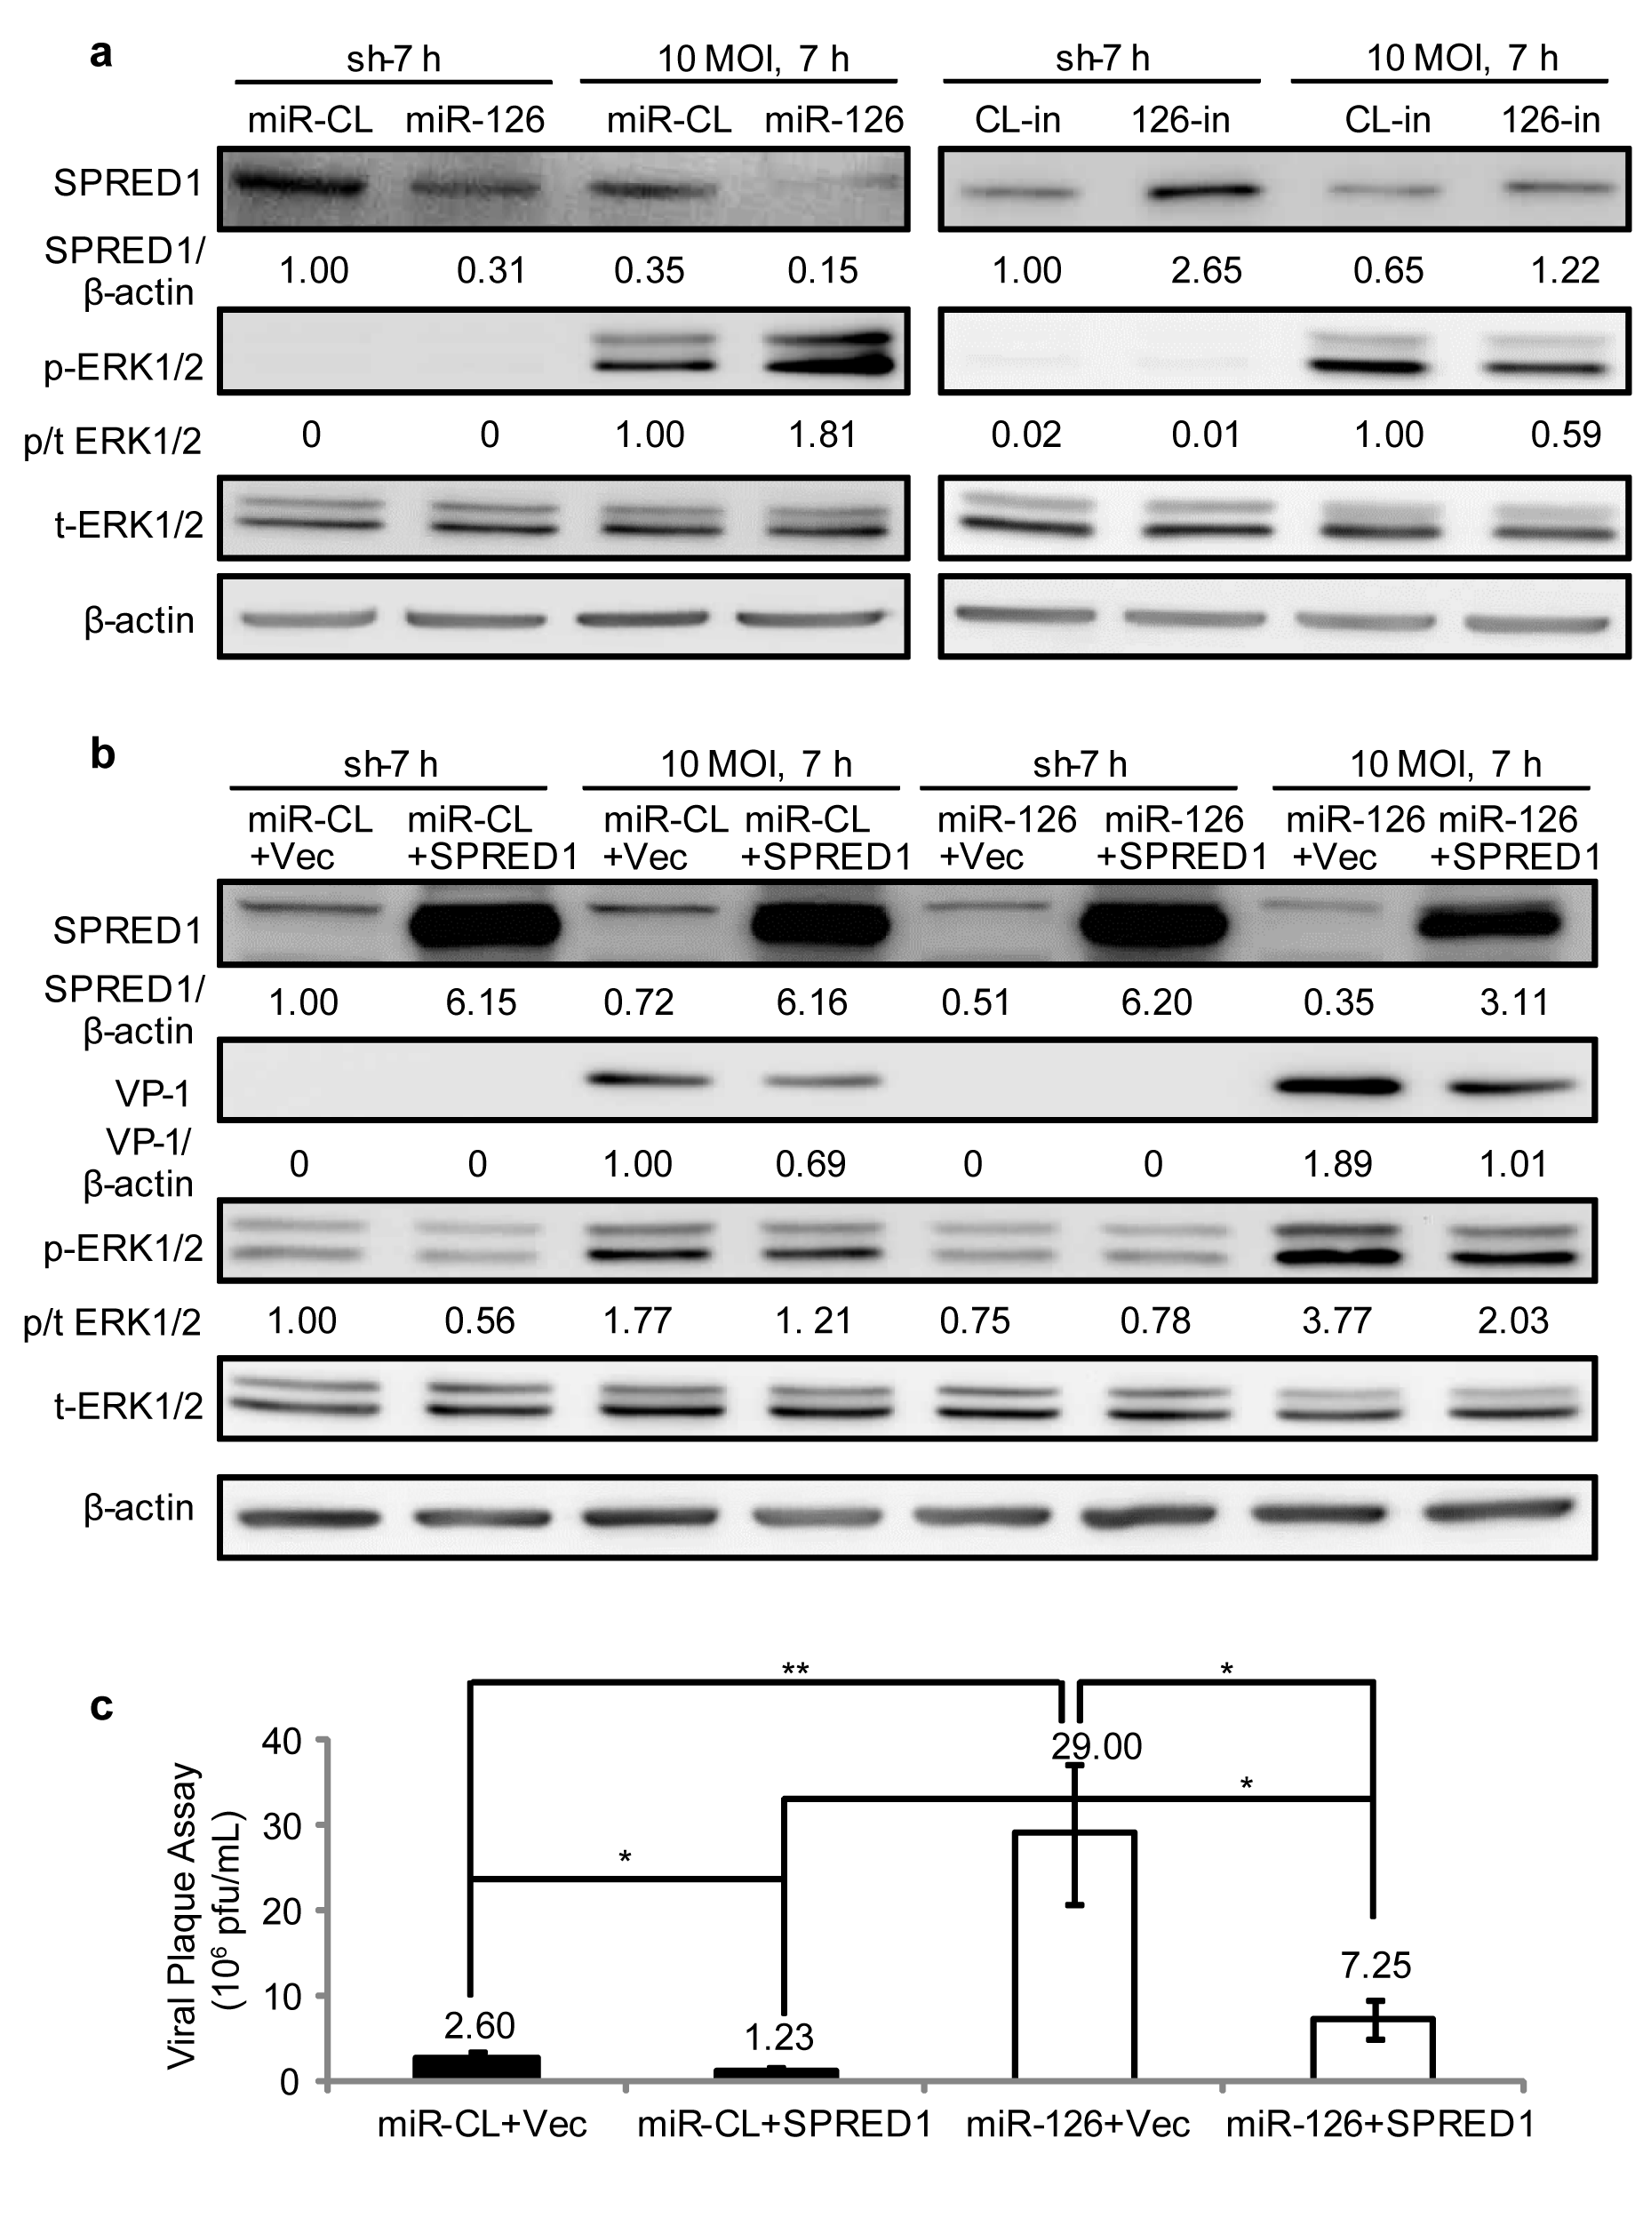
Study design – sources of bias
Common mistake:
Not knowing what is the linear range of your measure
or assay
Possible source of bias/variability:
Not testing within the linear range of the assay or methodology
Example: Western blot or other gel scanning-based measurement
May plateau
May or may not cross zero
You should never extrapolate, you do not know what the curve will look like beyond your data points = “lower and upper limit of detection”
Source: Xin Ye’s PhD thesis, UBC 2013

Slide 32
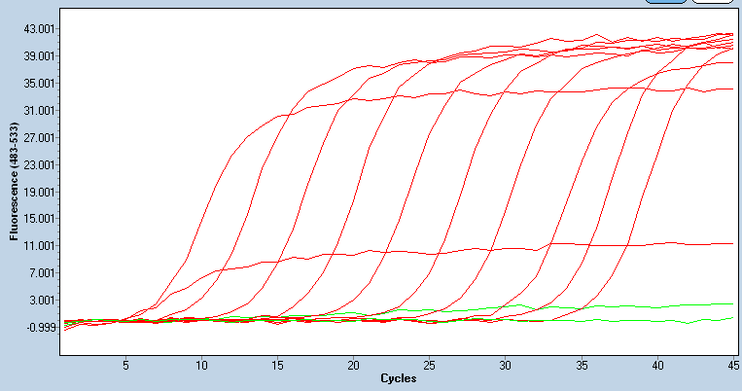
Study design – sources of bias
At very high DNA
Possible source of bias/variability:
Not testing within the linear range of the assay or methodology
Example: qPCR or RT-PCR
Higher DNA copy number enter exponential amplification earlier = at lower PCR cycle threshold (Ct)
At very high DNA concentrations,
PCR amplification is no longer efficient → outside the linear range of the assay
32

Slide 33
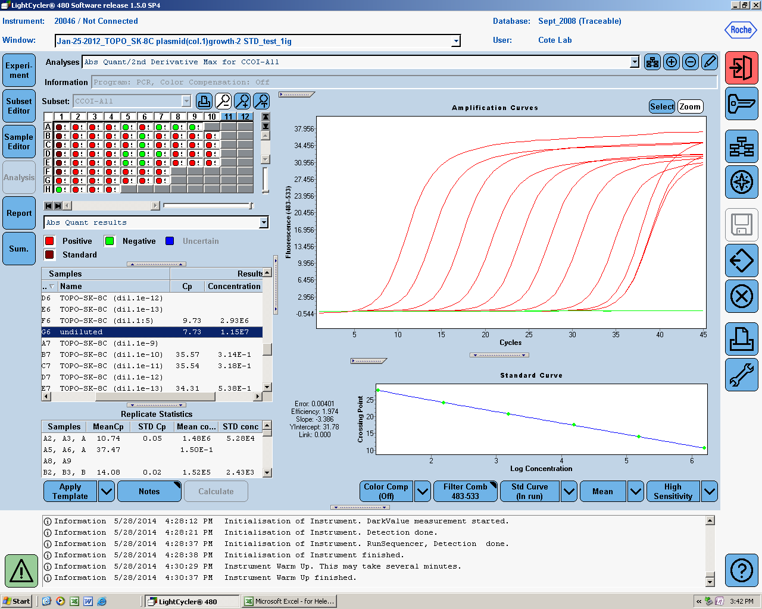
Study design – sources of bias
Important to plot values and determine what range can be used
Here, at low DNA concentration, linearity is not respected
= contamination?
or the number of DNA molecules is so small (<5) that the serial dilution is imprecise

Slide 34
Study design – sources of bias/error/variability
Example: mRNA studies using the ΔΔCt method (relative amplification = 2 ^{ΔΔCt})
Data: - C_{t} of gene of interest
- C_{t} of a housekeeping gene (to normalize)
- on both a test specimen and internal control aliquot
Assumption made: both genes (interest and housekeeping) have the SAME PERFECT PCR_{eff}
Ct
Log DNA concentration
Log DNA concentration
Log DNA concentration
Can only use this method if the assumptions are first verified…or all tested specimens have exactly the same DNA concentration
Similar problem can exist with any measure that is normalized to another

Slide 35
Study design – sources of bias/error/variability
Ct
Log DNA concentration
Log DNA concentration
Log DNA concentration
Upon serial dilution of the specimen
ΔCt
ΔCt
ΔCt
Log DNA concentration
Log DNA concentration
Log DNA concentration

Slide 36
Study design – sources of bias
Non-randomization, i.e. assaying all your control specimens in one batch/run and the treated specimens in a separate batch/run → Whenever possible, randomize everything before you start assaying
Unintentional or unconscious bias when collecting/analyzing data → Whenever possible, blind yourself
Differences in the buffer/diluent used between treatment and control or different time points, differences in the reagent lot, etc.
Data collection at different times (e.g., samples collected in 2000’s vs. controls collected in 2010’s = potential differences in collection protocol, processing, storage T° and time)
Data collection at different sites (example of Sick Kids vs. BC Children’s & Women’s)
It is often very difficult to identify the sources of error/bias. The best way to counter them is sound study design and attention to details. Time spent in designing a study is time well spent
Does not help if biases are discovered upon challenge by reviewers after the study is over, when biases can no longer be eliminated, and only dealt with as a limitation.

Slide 37
Study design – animal model experiments
What animal model?
Primates
Rats
Mice
Zebrafish
C elegans
Fruit flies
Choice depends on cost, relevance to disease/genetics, n needed

Slide 38
Study design – animal model experiments
Before you start:
Ethical considerations
Will you meet your objective and address your hypothesis?
Consider 3R (replace, refine, reduce)
Will it be a valid model of human disease?
Experimental (intervention → causes a change) or observational (no intervention → look for associations)
What strain? What phenotype? WT or transgenic?
Exploratory (hypothesis generating, sample size calculation) or confirmatory? or a mix? (pilot or final you hope to publish?)
Experimental unit = ? Each animal, each litter, each cage? → how many animals per cage?

Slide 39
Study design – animal model experiments
Also before you start:
Plan for randomization to assign treatment/intervention
- (↓ bias, perceived or not)
- can be done in Excel “=randbetween(bottom, top)”
Choice of outcome (primary, secondary)
- Measure Y at t=X
- Difference between measure at baseline and t=X
- Time to peak measure
- Area under the measure’s curve at t=X
- Slope of regression line for measure in each individual or group
- Survival analysis (time to death, disease, tumour, phenotype expression)
Choice of variables of interest (dose, time, sex, age, etc…)
- If there are too many important variables, a factorial design may be considered or you may increase your n to plan for a multivariable model

Slide 40
Study design – animal model experiments
What are the positive and negative controls? (if applicable)
Positive control → to prove that an effect can be seen (high dose, no treatment,..)
→ n may be smaller
Negative control (sham surgery, placebo treatment, etc…)
More than one positive and one negative control may be appropriate
Show that the effect is not observed with an unrelated treatment

Slide 41
Study design – animal model experiments
Sources of variability include all those of cell culture experiments +
- Age
- Sex
- Environment (light, cage size, chow, noise, number of animal per cage, etc…)
- Different operator/staff
- Inter-animal variability
When multiple independent sources of variation are present, the variance of the measurement is influenced by all sources of variances.
If transplanting/grafting, what strains?
- isogenic/syngeneic? (same genetic material)
- with or without functional immune system? (SCID, nude)
How many animal per group?
- feasibility (time, $)
- variability of the parameter you are investigating
- pilot or not?
- expected size of the effect?
- statistical power needed
41
41
41
41
41
41
41
41
41
41
41

Slide 42
Study design – animal model experiments
Types of replicates
1. assay or replicates (same cell pellet assayed X time)
2. experimental replicates (number of animal per group)
3. biological replicates (different strain or animal models?)
Need for blocking?
- If too many animals to process all in one day, may need to divide the experiment in smaller blocks
- Within litter experiment? (transgenic ^{+/-} vs. within litter ^{+/+} or ^{-/-})

Slide 43
Animal studies – EDI considerations
Why is it important to study sex?
How can your study design ensure that sex is considered?
Is sex known to affect your measure of interest? (review the literature)
If unknown, include both sexes and explore sex effects
Design so there is sufficient power to include sex as a variable
If yes, sex really should be considered during study design and analyses
There should be sufficient power to do sex-segregated analyses
Grant proposals now require an entire section on how sex and gender (gender not an issue in animal studies) will be considered in the proposed research.
Common mistake:
Assuming that it is acceptable to not address it because that is how research has always been

Slide 44
Animal studies – types of studies
What type of study will most efficiently test your hypothesis?
Cross-sectional (treated vs. untreated) at a single time point
Longitudinal (treated vs. untreated), (more powerful)
- Collect data at baseline and at the end of treatment
Collect data at several intervals
serial measures on the same animals
drop-out studies if tissue collection required
Dose-response (cross-sectional or longitudinal)
- study different doses of the treatment
Any use of historical data?
Then determine the sample size you need to have sufficient power
Unless very simple, may want to talk to a biostatistician

Slide 45
Animal studies – resources
Festing MFW & Altman DG. Guidelines for the design and statistical analysis of experiments using laboratory animals. ILAR Journal (2002) 43(4): 244
http://www.3rs-reduction.co.uk/assets/applets/Festing_Altman.pdf
Hooijmans CR et al., A Gold Standard Publication Checklist to Improve the Quality of Animal Studies, to Fully Integrate the Three Rs, and to Make Systematic Reviews More Feasible. (2010) ATLA 38:167
file:///C:/Documents%20and%20Settings/hcote/My%20Documents/Downloads/Hoojimans%20FINAL.pdf
Design of experiments via factorial designs
https://controls.engin.umich.edu/wiki/index.php/Design_of_experiments_via_factorial_designs

